Slide 1
PYRAMINX SOLVER
Prepared by : Krunal Bhavsar
Lab Faculty : Sandip Patel Sir

Slide 2
Contents
Objective
About Pyraminx puzzle !
Why I selected this project ?
How I made this algorithm ?
Project Working
Limitation
Future implementation

Slide 3
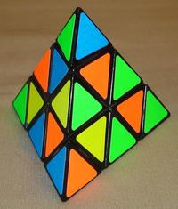
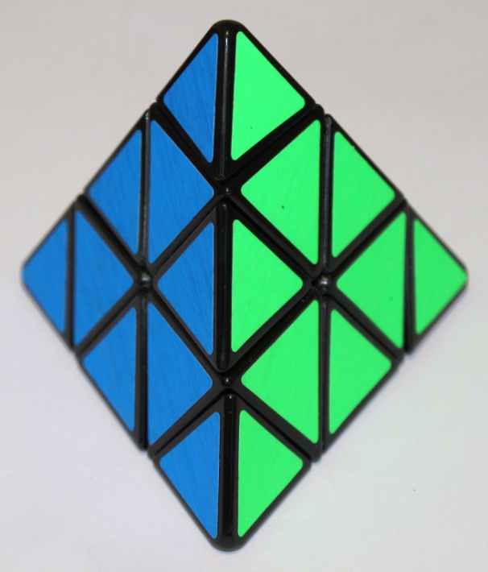
Objective
Computer will show us steps required to solve scrambled pyraminx .
R R L U F1 F2 U B B F4 R L

Slide 4
About Pyraminx puzzle !
The Pyraminx, also known as the triangle Rubik's Cube is a tetrahedron-shaped 3-layered twisty puzzle, having four triangular faces which are all divided into nine identical smaller triangles. This is the second best selling puzzle toy in the World after the Rubik's Cube with over 100 million pieces sold.

Slide 5
About Pyraminx puzzle !
There are 75,582,720 possible positions.
The maximum number of twists required to solve the Pyaminx is 11.
The world record fastest Pyraminx solve is 0.91 seconds.

Slide 6
Why I selected this project ?
There are some android application available which can solve 3*3 Rubik’s cube but there is no application which can solve Pyraminx puzzle .
So I come with the idea to make an algorithm which can solve Pyraminx puzzle .

Slide 7
How I made this algorithm ?
Fist I learnt that how to solve pyraminx .
There are five steps require to solve this .
STEP 1 - SOLVING THE TIPS
STEP 2 - SOLVING SOME MORE
STEP 3 - FINISHING THE BLUES
STEP 4 - THE SECOND LAYER
Step 5 – THE THIRD LAYER

Slide 8
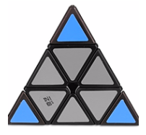
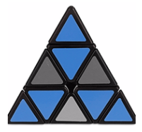
STEP 1 AND STEP 2
STEP 1–SOLVING THE TIPS
STEP 2–SOLVING SOME MOR E

Slide 9
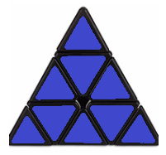
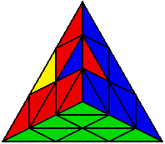
STEP 3 AND STEP 4
STEP 3-FINISHING THE BLUES
STEP 4-THE SECOND LAYER

Slide 10
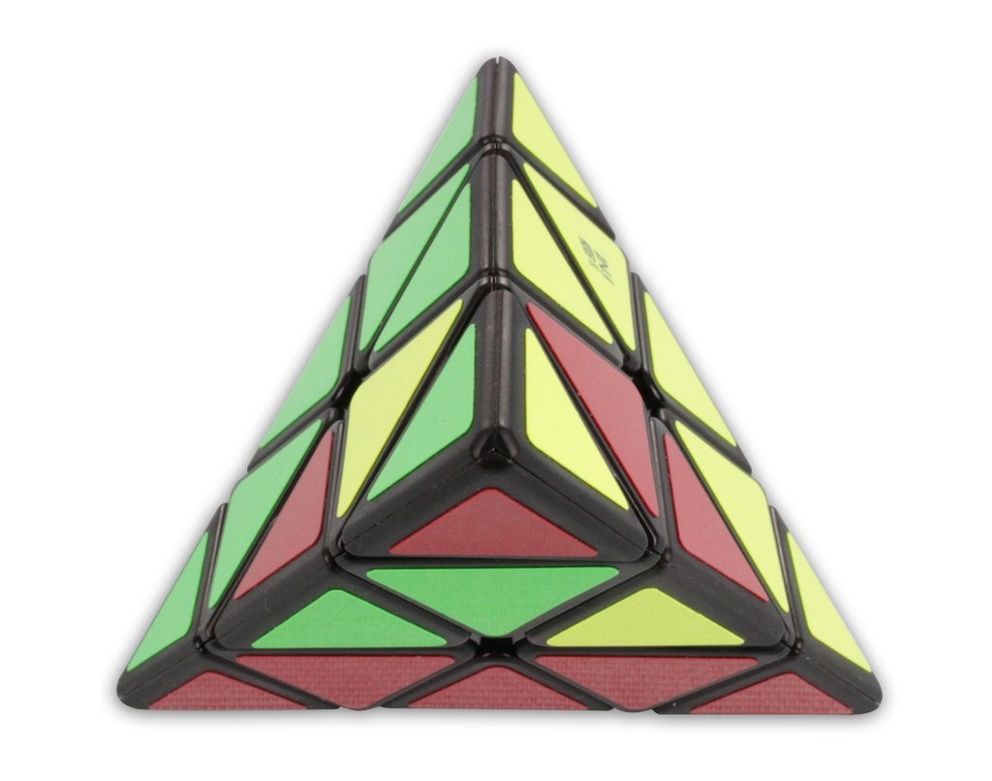
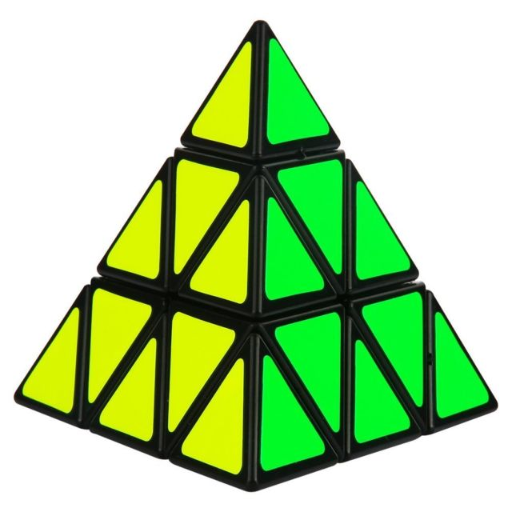
STEP 5 AND SOLVED
STEP 5-THE THIRD LAYER
SOLVED

Slide 11
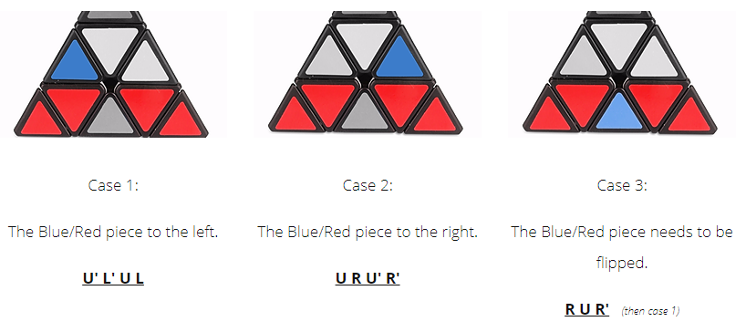
How I made this algorithm ?
By analyze different cases which are possible in every steps .
Ex. In step4 there are some colour possibilities

Slide 12
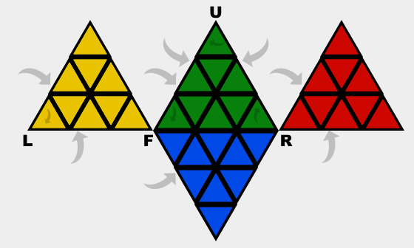
PROJECT WOKING
I made algorithm in C++ using matrix concept.
So let us see how to enter colours
A3
A2
A4
A1

Slide 13
PROJECT WORKING
For input
Output
You have to enter colour code for every layer row by row
For red – r
For blue – b
For green – g
For yellow – y
Easy meaning of steps
L – left
R – right
U – up
B – back

Slide 14



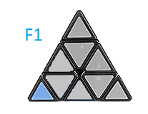
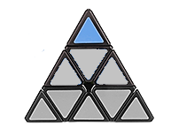
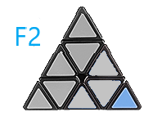
PROJECT WORKING
NOTATIONS
B
For back
F3
For back
F4

Slide 15
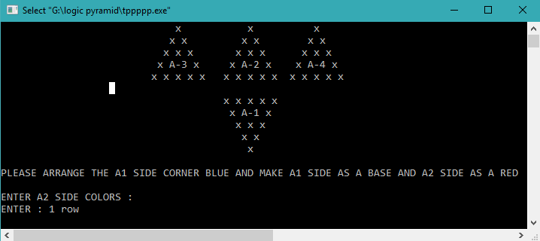
PROJECT WORKING
OUTPUT :

Slide 16
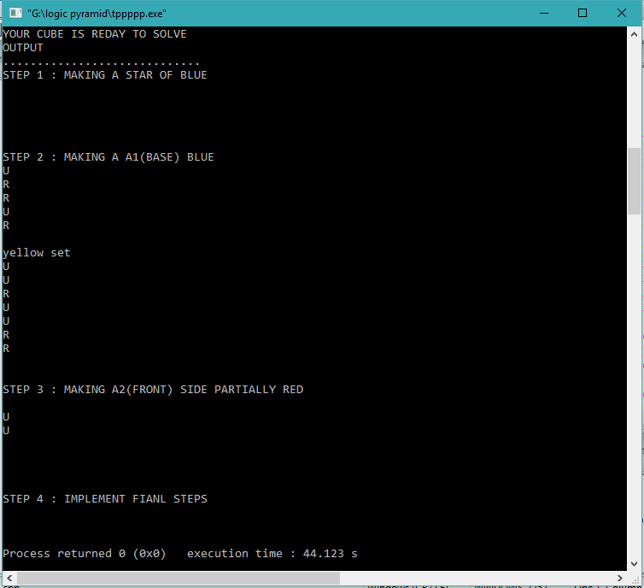

Slide 17
LIMITATION
User need to do first step and fix the position

Slide 18
FUTURE IMPLEMENTATION
Made this algorithm in python so I can reduce steps using concept of lists and modules maybe .
Overcome the limitation.
Then will try to make a 3D model of pyraminx in unity or blender and apply this algorithm to solve it .

Slide 19


